Slide 1
Family Time in the Digital Age:
A Time-Use Diary Analysis
Dr. Stella Chatzitheochari

Slide 2
Mullan, K. & Chatzitheochari, S. (2019) Changing Times Together? A Time-Diary Analysis of Family Time in the Digital Age in the United Kingdom, Journal of Marriage and Family

Slide 3
Family Time in the Digital Age
Concerns surrounding widespread diffusion of mobile devices and their impact on face-to-face interactions and quality time
Did technological change have a negative impact on family time?
1) Small-scale studies: mixed evidence, not generalisable
2) Screen time social survey measures: calculation difficulties, parent proxies & screen time as “main” activity
3) Time-diary studies: increase of time parents spend with children over time but no research on screens & unidimensional measure of family time

Slide 4
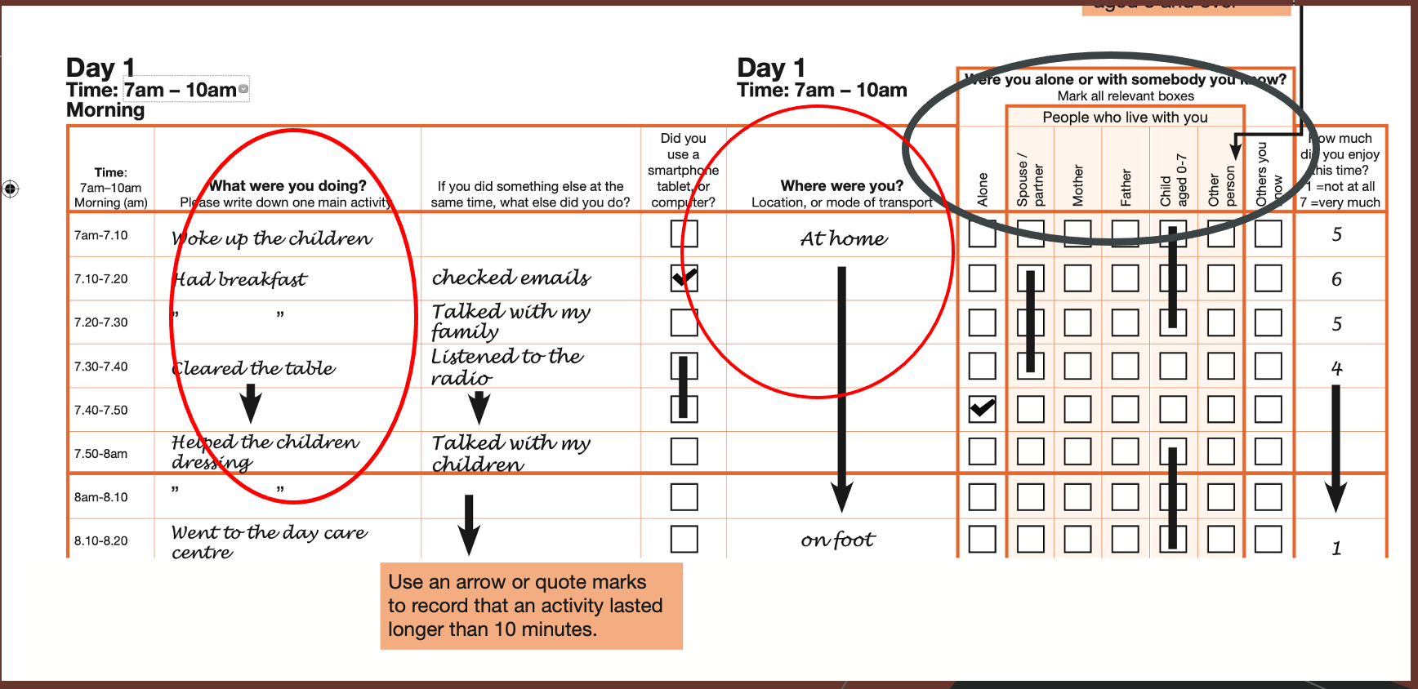
UK 2014-2015 Time Use Survey

Slide 5
Family Time Measures
Total Family Time – time children and parents spend together at the same location (mostly at home 81% in 2000 and 80.5% in 2015) (“location” diary column)
Co-present Time - children reported being co-present with their parents (“who with” diary column)
Alone-Together Time – children do not report being co-present with parents (“who with diary” column)
Total Time in Shared Activities (”main activity” column)
Total Time in Eating, Television Viewing, Leisure (“main activity” column)
UK 2000 and 2014-2015 Time Use Survey
Household surveys, everyone aged 8 and over filled in a diary

Slide 6
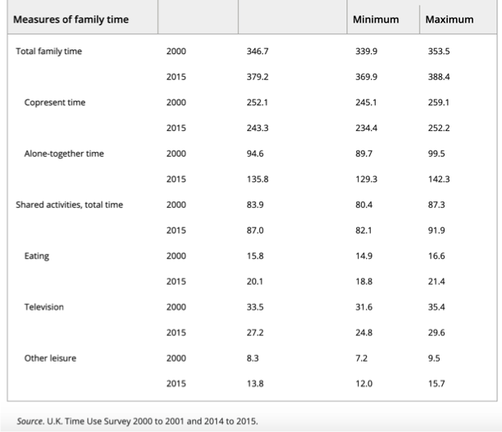

Slide 7
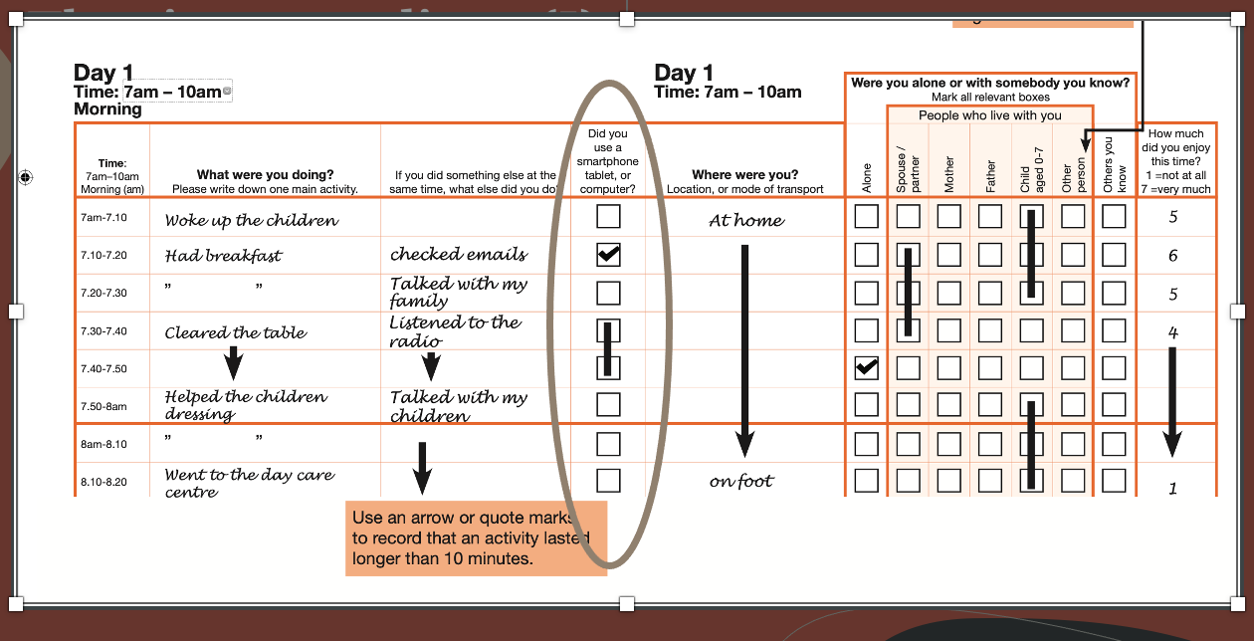
Mobile Devices Taking Over Family Time?
Cross-sectional analysis using ”device use” column in the 2015 UKTUS diary

Slide 8
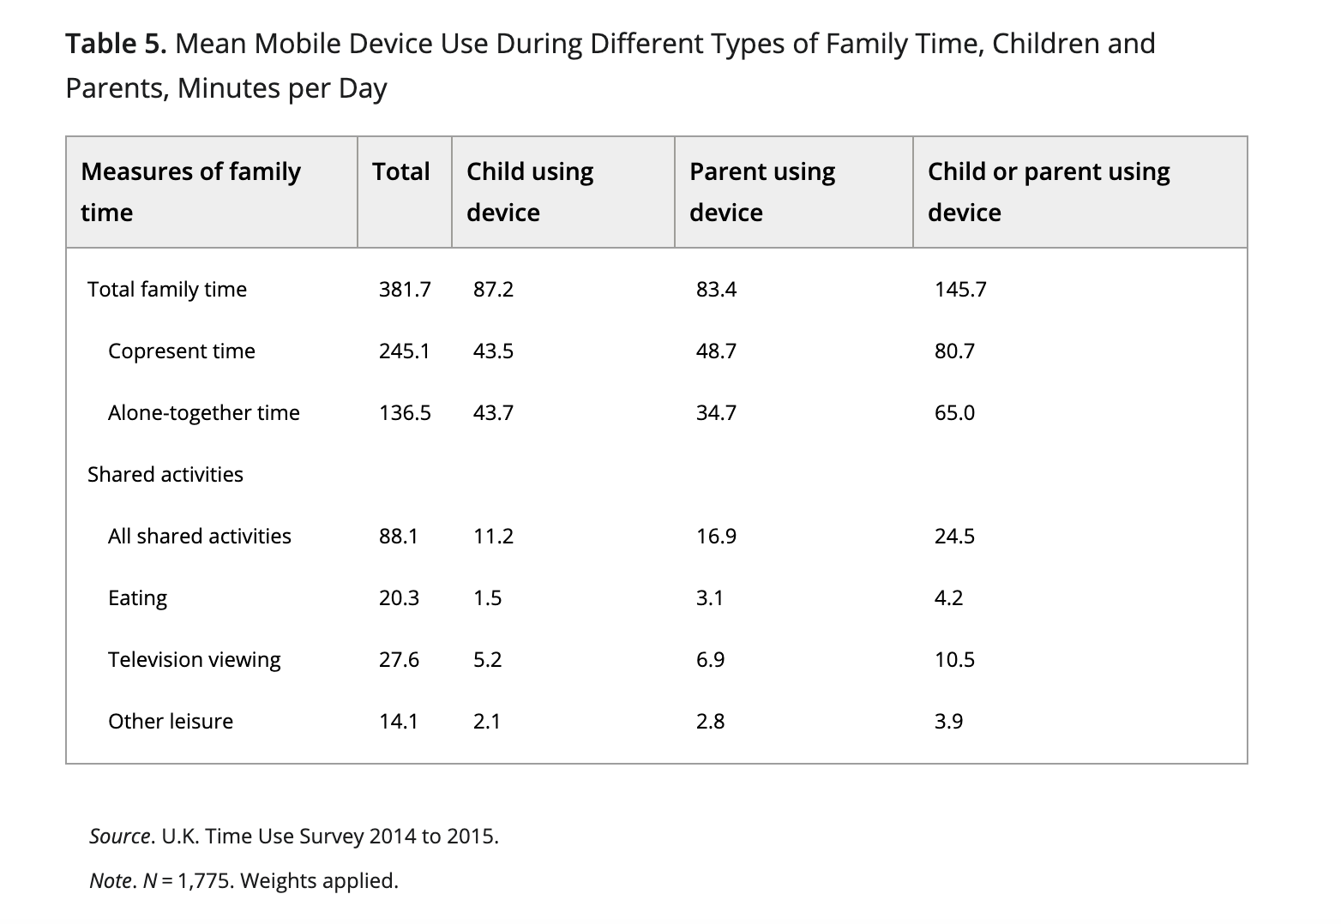

Slide 9

Time-Use Diaries, Family Time, and Screens
By using “location” and “who with” columns we were able to capture varying levels of togetherness among family members, not possible by conventional survey questionnaires
Time diaries provide a more comprehensive picture of internet enabled mobile device use (“device use” column, more in line with “real life” use of screens and internet

Slide 10
www.ncrm.ac.uk

